Slide 1
Operating Systems
4. Multithreaded Programming
4-Threads
1

Slide 2
Recall the Main Concepts Behind Processes
Resource Ownership
Virtual address space to hold the process image
Program
Data
Stack
Attributes
OS shields processes from interfering with each others resources
Protection
Scheduling/ Dispatching
Execution may be interleaved with other processes
Maintain execution states, etc.
Can we decouple this functionality?
2

Slide 3
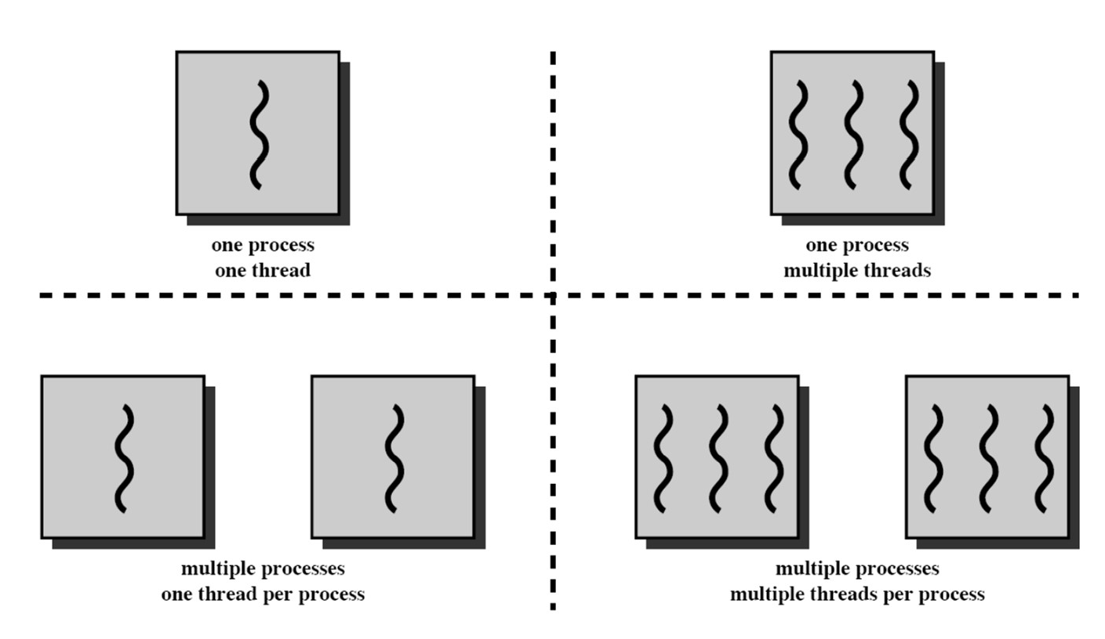
Processes and Threads
Multithreading: More than one entities can possibly execute in the same resource- (i.e., process-) environment (and collaborate better)
Unit of dispatching
Referred to as a thread
Unit of resource ownership
Referred to as a process or task
3

Slide 4
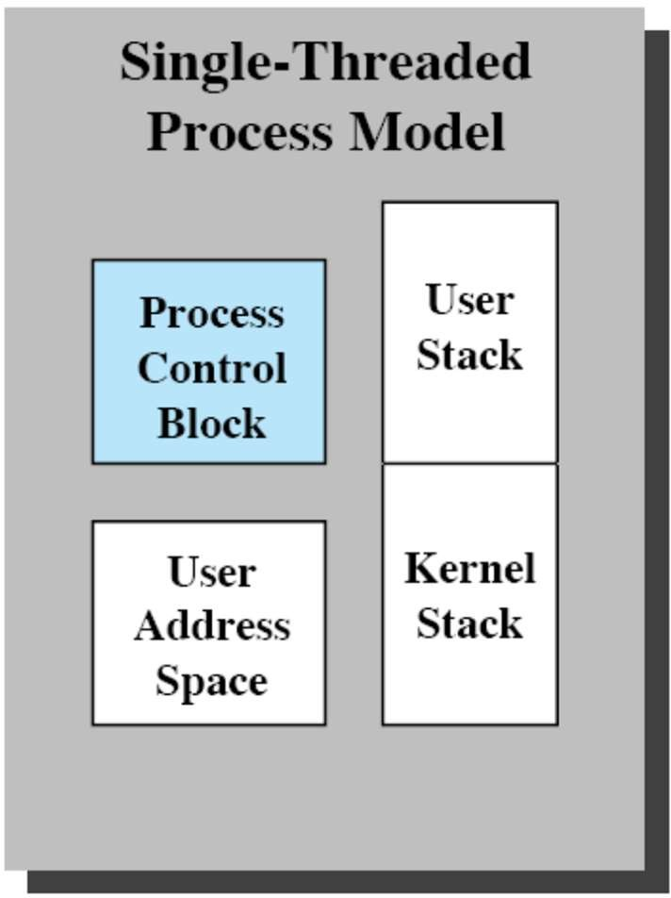
Processes vs. Threads
Process characteristics
A virtual address space
Holds the process image
Global variables, files, child processes, signals and signal handlers
4

Slide 5
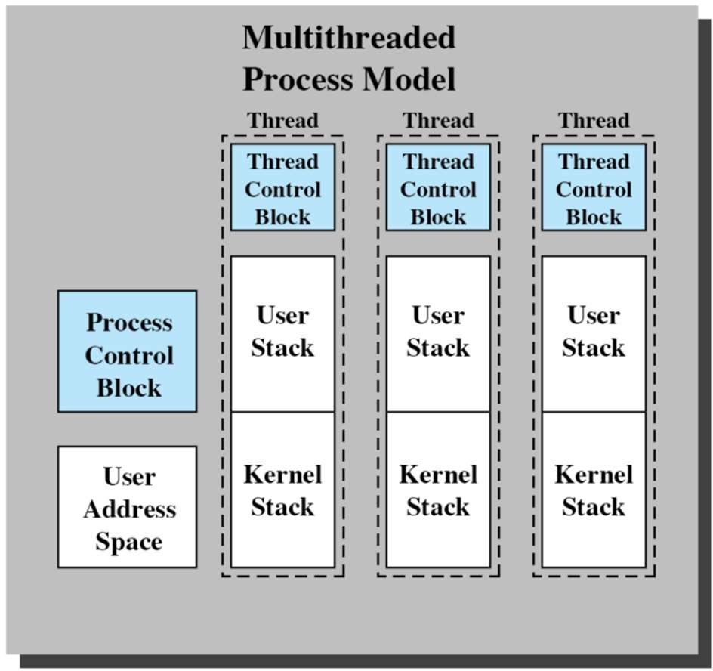
Processes vs. Threads
Process characteristics
A virtual address space
Holds the process image
Global variables, files, child processes, signals and signal handlers
Thread characteristics
An execution state, stack and context (saved when not running)
Access to the memory and resources of its process
All threads of a process share this
Some per-thread static storage for local variables
5

Slide 6
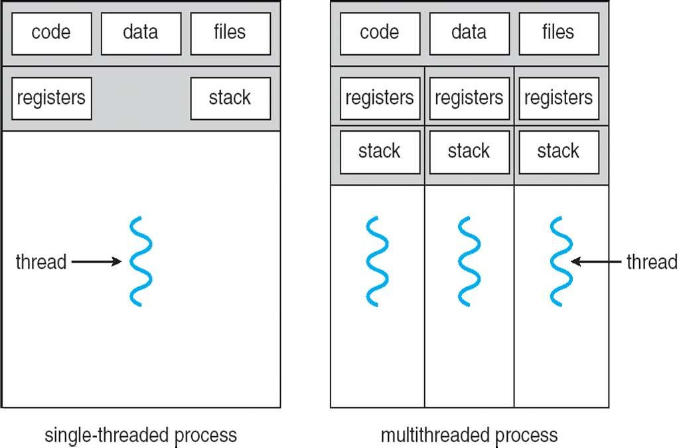
Processes vs. Threads
6

Slide 7
Processes vs. Threads
Address space/Global Variables Open files
Child processes Accounting info Signal handlers Program counter Registers
Stack State
In case of multiple threads per process
Split
Unit of Resource
Unit of Execution/Dispatch
Address space/Global Variables
Open files Child processes Accounting info Signal handlers
Program counter
Re
gisters ack ate
Program counter
Program counter Registers
Stack State
St St
Registers Stack State
Share
7

Slide 8
Benefits of Threads
Easy/Lightweight Communication
Threads within the same process share memory and files
Communication does not invoke the kernel
May allow parallelization within a process
I/O and computation to overlap
Recall historical evolution from uni-programming to multiprogramming
Concurrent execution in multiprocessors
Takes less time to
Create/terminate a thread than a process
Switch between two threads within the same process
8

Slide 9
Uses of Threads
Overlap foreground with background work
Decouple interactions from processing
For instance processing message requests
Thread I
Wait for message Store result in buffer
2. Asynchronous processing
– Backup while editing
Thread II
Wait for message Store result in buffer
3. Speed up execution
– Parallelize independent actions
Thread III Consume messages in buffer
4. Modular program structure
– Must be careful here, not to introduce too much extra overhead
Thread IV Consume messages in buffer
Increase throughput in message processing
9

Slide 10
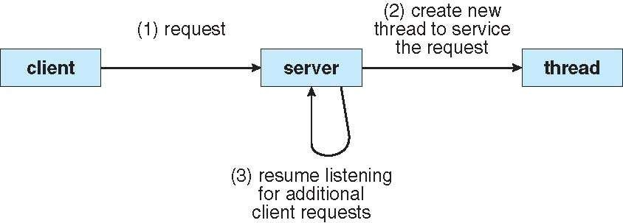
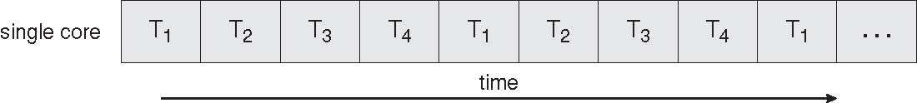
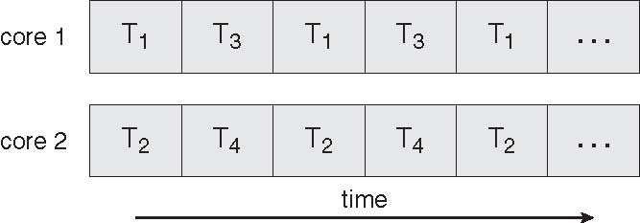
Multithreaded Server Architecture – Example
Parallel execution on single core and multicore
4-Threads
10

Slide 11
Effect of Suspension/Termination
Suspending a process involves suspending all threads of the process since all threads share the same address space
Termination of a process, terminates all threads within the process

Slide 12
Types Of Threads
User Level Threads
Kernel Level Threads

Slide 13
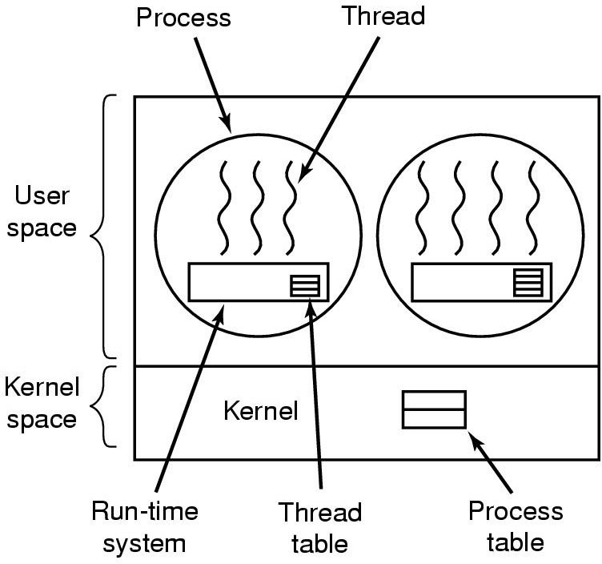
Implementing Threads in User Space
The kernel is not aware of the existence of threads
Run-time system (thread-library in execution)
Responsible for bookkeeping, scheduling of threads
Allows for customized scheduling
Support for any OS
But: problem with blocking system calls
Blocking of a thread causes blocking of the process
Threads cannot execute if a thread of the same process is blocked

Slide 14
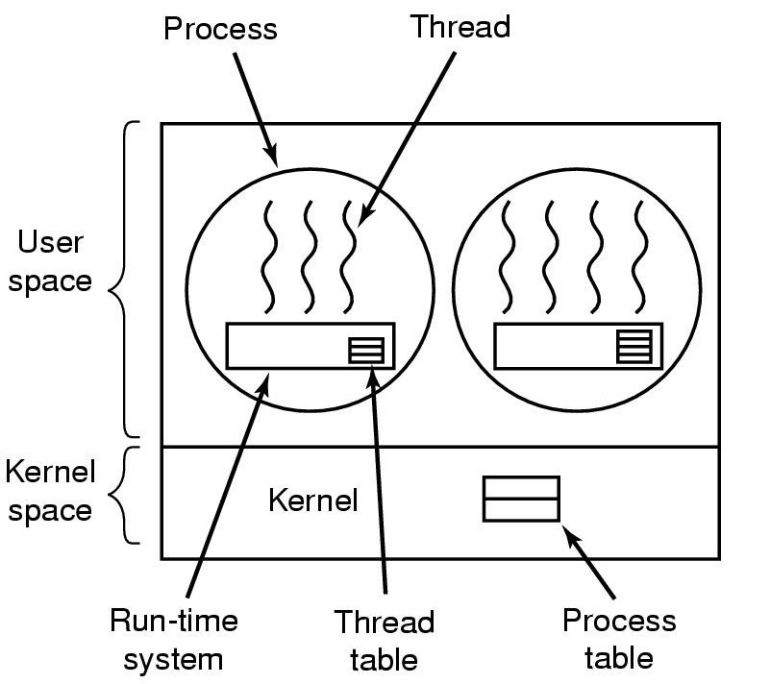
Implementing Threads in User Space
The thread library contains code for
Creating and destroying threads
Passing messages and data between threads
Scheduling thread execution
Pass control from one thread to another
Saving and restoring thread contexts
Three primary thread libraries:
POSIX Pthreads
Win32 threads
Java threads

Slide 15
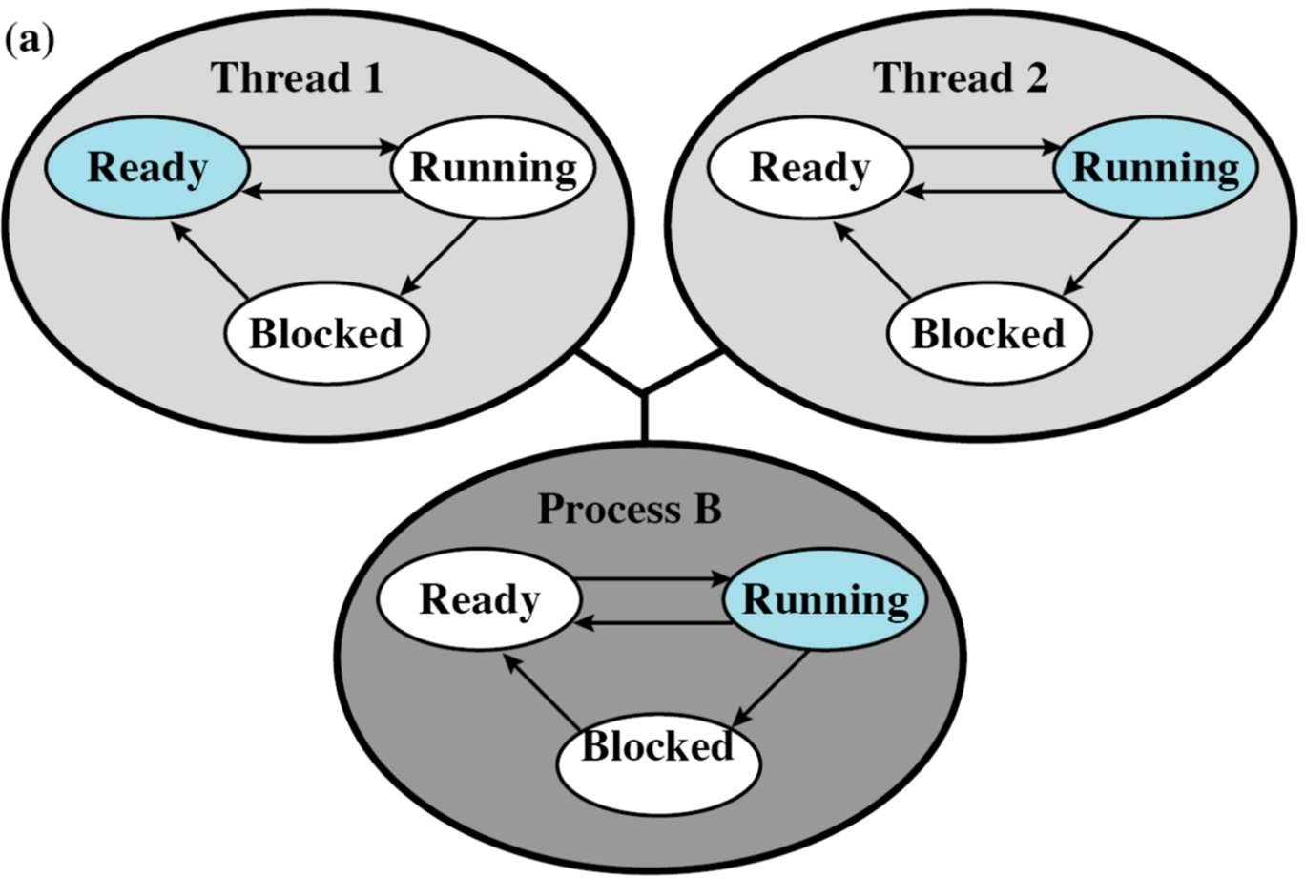
Example: User-Level Thread Execution
Consider a thread makes a system call

Slide 16
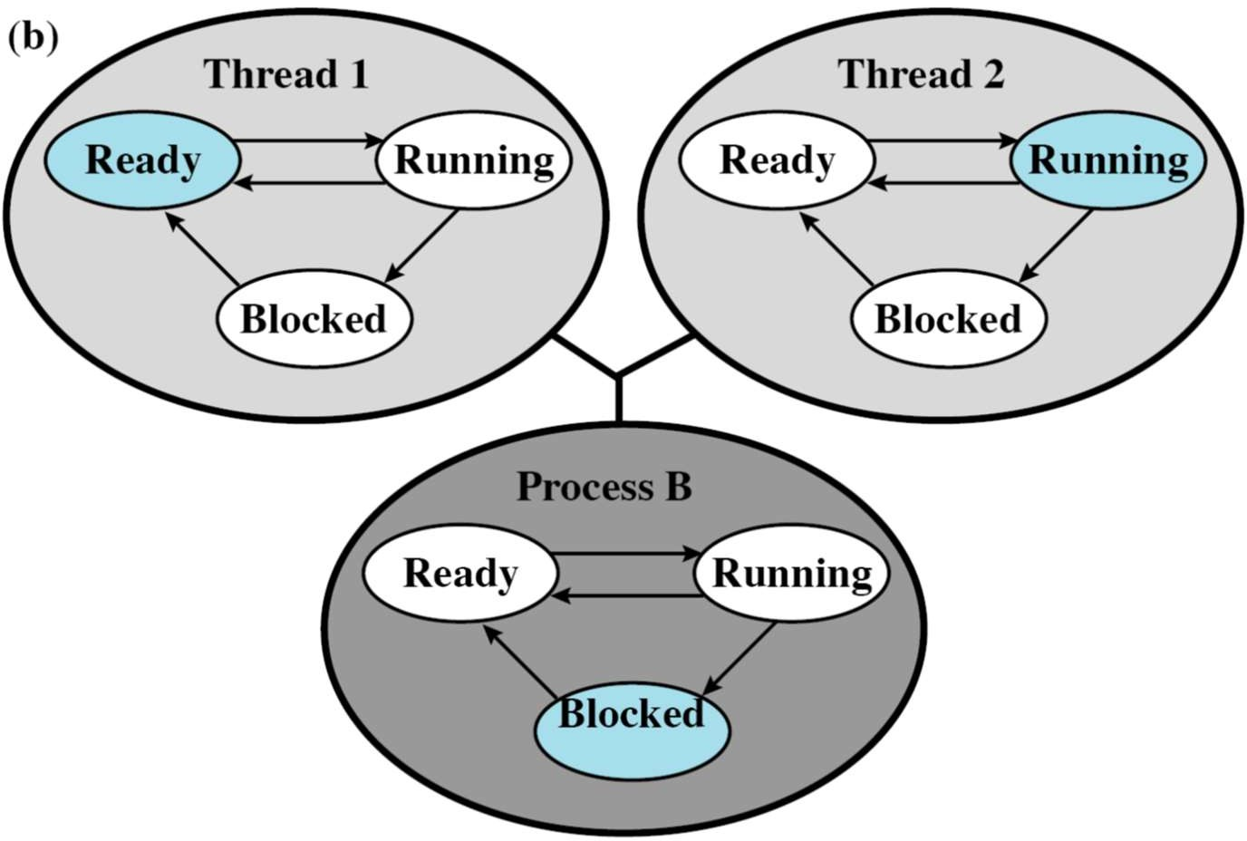
Example: User-Level Thread Execution
Process switches to blocked state
State of Thread 2 remains running, but Thread 2 cannot execute instructions

Slide 17
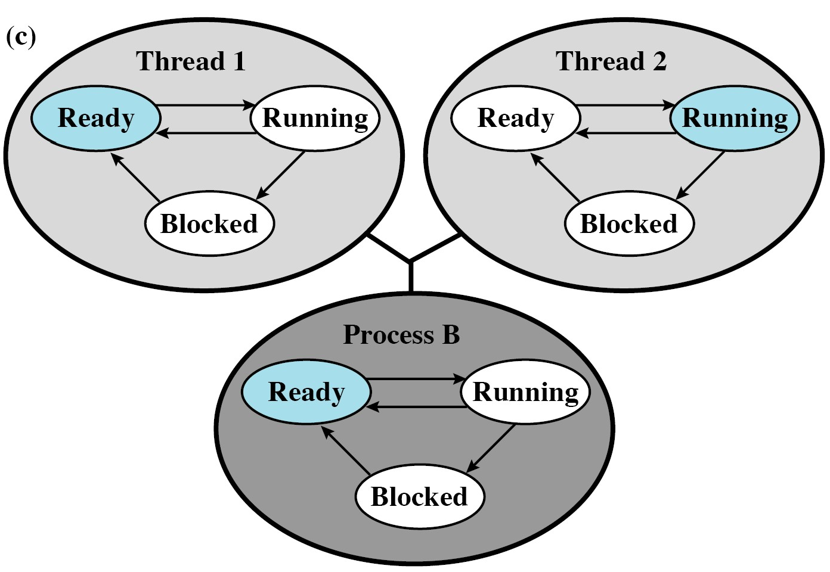
Example: User-Level Thread Execution
Process switches to ready state
– Returned from the system call

Slide 18
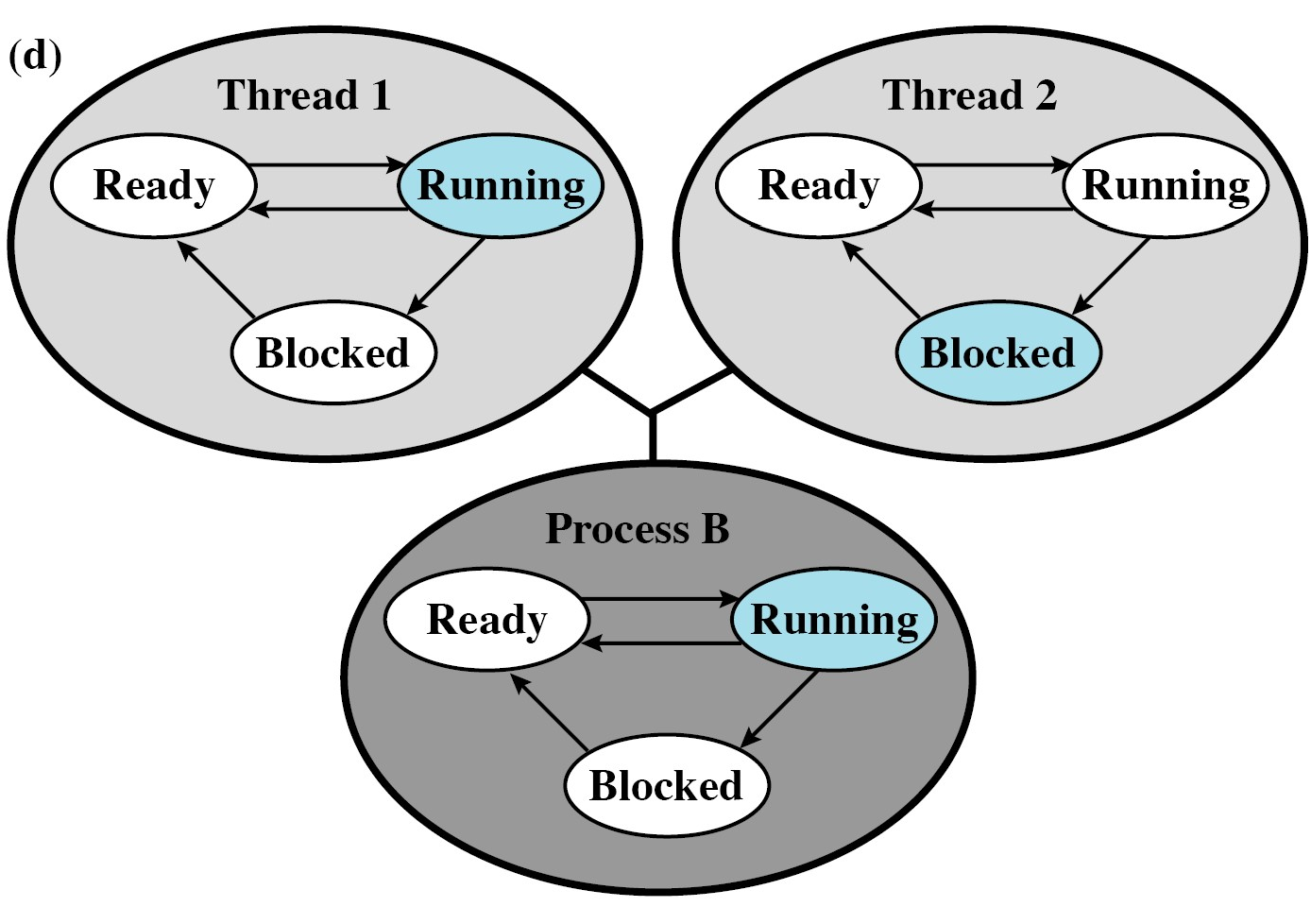
Example: User-Level Thread Execution
Thread 2 needs to wait for some action of Thread 1

Slide 19
User-Level Thread
Advantages
Fast
Do not need context switching to kernel mode to perform thread management
Scheduling can be application specific
Choose the best algorithm for the situation
Can run on any OS
Only a thread library is required
Disadvantages
Most system calls are blocking for processes
All threads within a process will be implicitly blocked
Cannot benefit from the multiprocessor system
Kernel assign one process to only one CPU

Slide 20
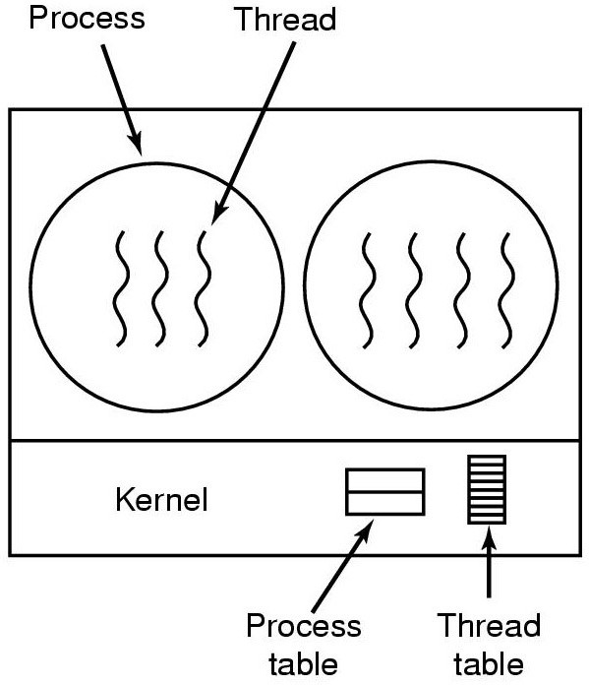
Implementing Threads in Kernel/Lightweight Process
Scheduling
Happens on a thread basis
Does not suffer from the “blocking problem”
Threads of a process can be scheduled on multiple processors
Less efficient than user-level threads
Kernel is invoked for thread creation,
Termination
Switching
Kernel maintains context information for the process and the threads

Slide 21
Kernel-Level Thread Support
Windows XP/2000
Solaris
Linux
Tru64 UNIX
Mac OS X

Slide 22
Kernel-Level Thread
Advantages
In multiprocessor system, mutiple threads from the same process can be scheduled on multiple processors
Blocking at thread level, not process level
– If a thread blocks, the CPU can be assigned to another thread in the same process
Even the kernel routines can be multithreaded
Disadvantages
Thread switching always involves the kernel
Two context switches per thread switch
Slower compared to User Level Threads
Faster than a full process switch

Slide 23
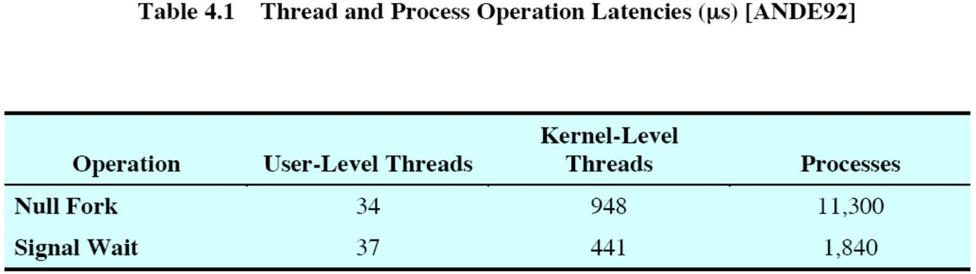
Some Performance Data
Null Fork: Overhead of creating a process or thread
Signal Wait: Overhead of synchronizing two processes or threads together

Slide 24
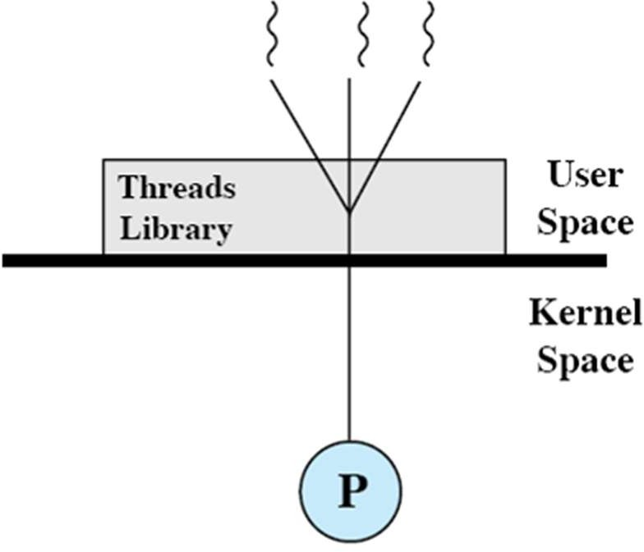
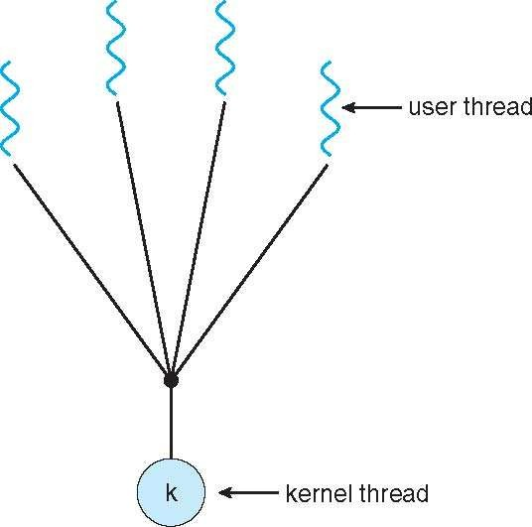
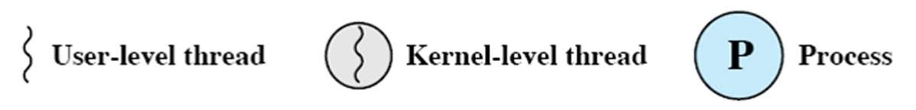
Multithreading Models: Many-to-one Model
Many user-level threads mapped to single kernel thread
Examples:
Solaris Green Threads
GNU Portable Threads

Slide 25
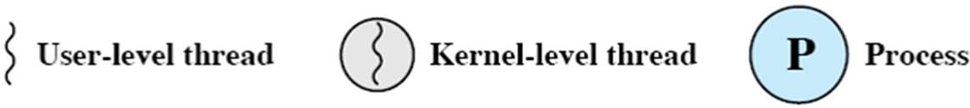
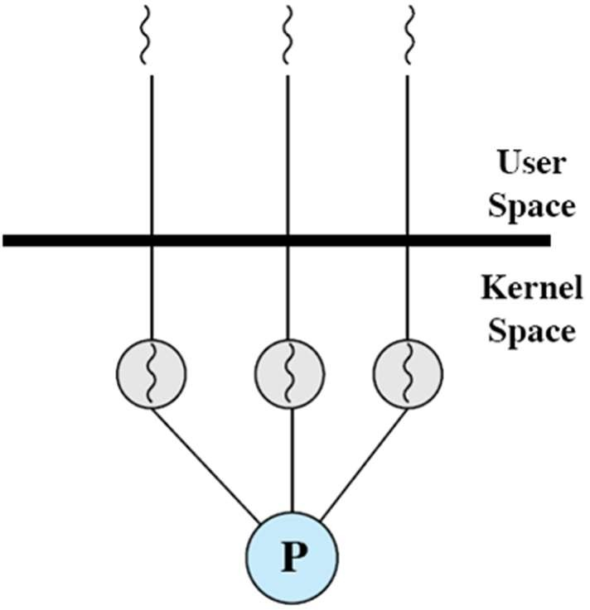
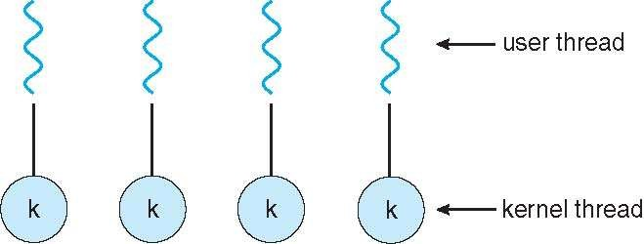
Multithreading Models: One-to-one Model
Each user-level thread maps to kernel thread
Examples
Windows NT/XP/2000
Linux
Solaris 9 and later

Slide 26
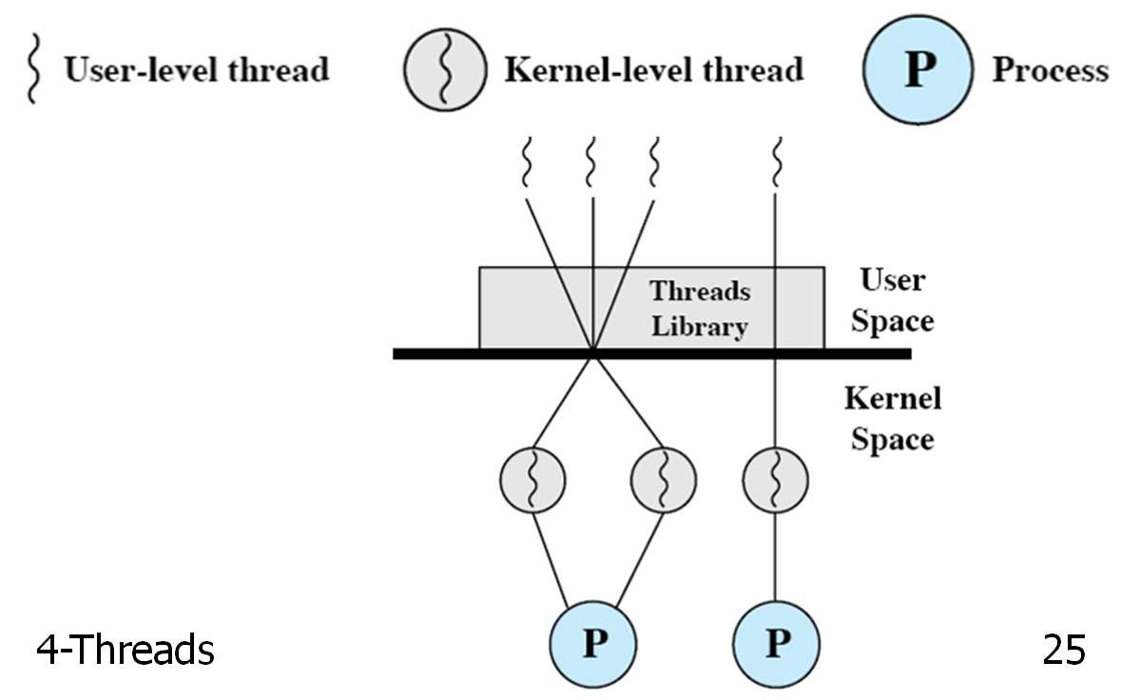
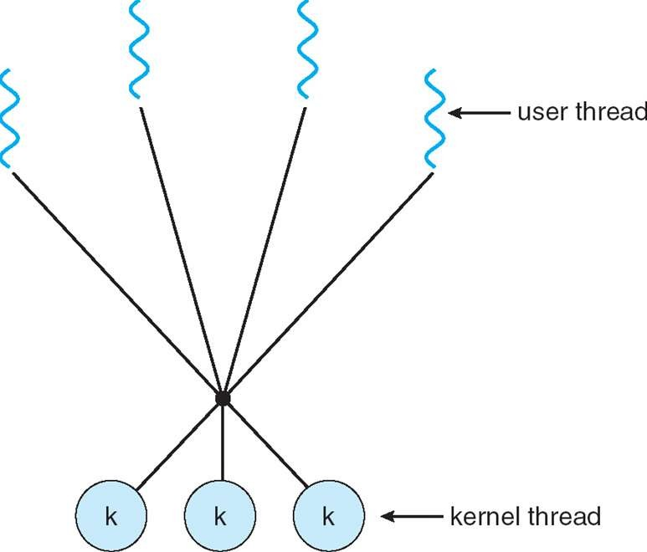
Multithreading Models: Many-to-Many Model
Allows many user level threads to be mapped to many kernel threads
Allows the operating system to create a sufficient number of kernel threads
Example:
Solaris prior to version 9
Windows NT/2000 with the ThreadFiber package

Slide 27
Windows: Threads and Processes
CreateProcess ExitProcess
CreateThread ExitThread
CreateFiber ExitFiber SwitchToFiber
Collection of processes
WIN32 API
Jobs
Process
Process
Kernel-level threads
Thread
Thread
Thread
User-level threads
Fiber
Fiber
Fiber

Slide 28
Windows XP: Threads and Processes
Each thread contains
A thread id
Register set
Separate user and kernel stacks
Private data storage area
The register set, stacks, and private storage area are known as the context of the threads
The primary data structures of a thread include
ETHREAD (executive thread block)
KTHREAD (kernel thread block)
TEB (thread environment block)

Slide 29
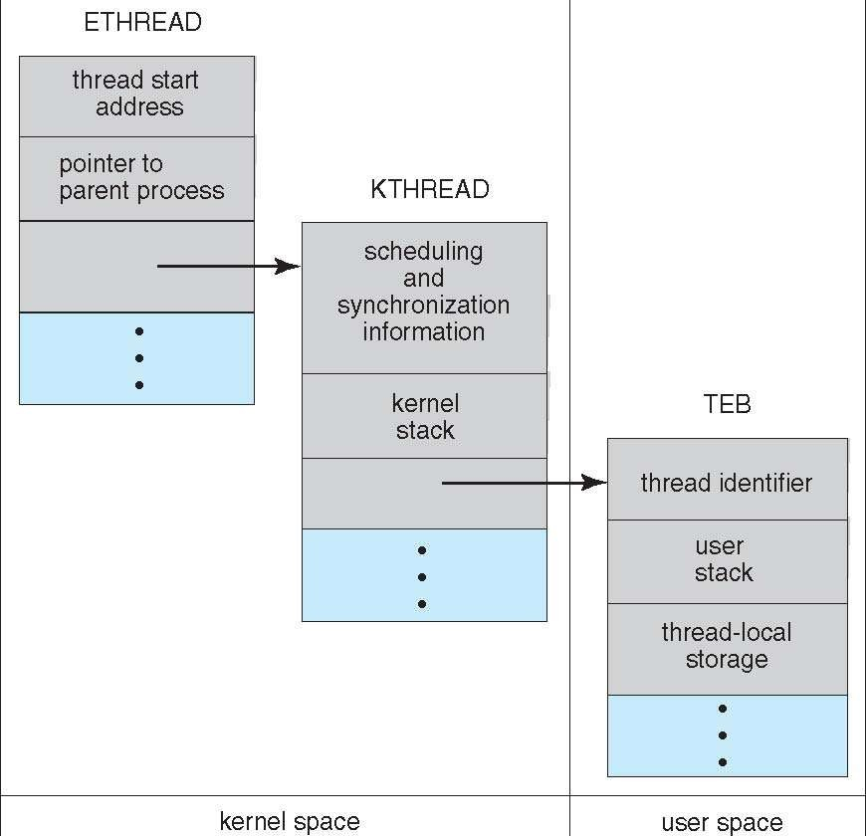
Windows XP: Threads and Processes

Slide 30
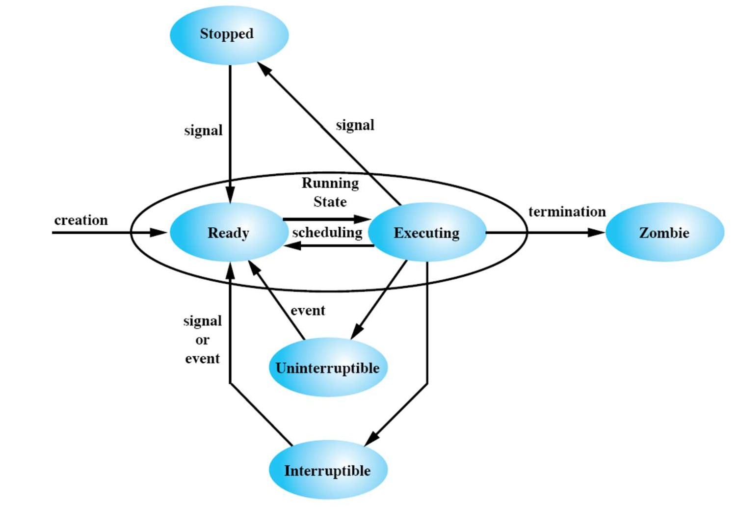
Linux Task Management
Linux uses task as a placeholder for processes and threads
Task creation
Specify resources to be inherited from the parent
Share file system information
File descriptors
Memory space
…
Notes:
Interruptible Process (also known as "Interruptible Sleep" or "Interruptible State"):
An interruptible process is a process that is capable of being interrupted by signals.
When a process is in an interruptible state, it is typically waiting for some event to occur, such as I/O operations, and is receptive to signals from the kernel or other processes.
The process can be paused or terminated by an external signal, and it can respond to signals like SIGINT (interrupt signal) or SIGTERM (terminate signal).
Commonly, interruptible processes are in states such as "TASK_INTERRUPTIBLE" in the Linux kernel scheduling.
Uninterruptible Process (also known as "Uninterruptible Sleep" or "Uninterruptible State"):
An uninterruptible process is a process that is not receptive to most signals, including those that could lead to termination.
These processes are typically in a critical section of code where they are waiting for a specific event, such as waiting for disk I/O to complete.

Slide 31
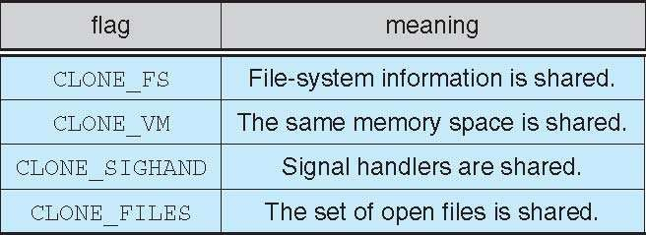
Linux Task Management
fork() and clone() system calls
clone() takes options to determine sharing between parent and child tasks
No sharing takes place, if none of above flags is set when clone()
is invoked
– Functionality similar to that provided by fork() system call

Slide 32
Linux Task Management
Unique kernel data structure (struct task_struct) for each task
Instead of storing data, contains pointers to other data structures
For example, data structure that represent
open files
Signal handlers
Virtual memory
When fork() is invoked
New task is created with copy of all associated data structures of the parent process (task)
When clone() is invoked
New task points to the data structure of the parent process (task)
Depending on the set of flags passed to clone( )

Slide 33
Thread Libraries
Thread library provides programmer with API for creating and managing threads
Two primary ways of implementing
Library entirely in user space
Kernel-level library supported by the OS

Slide 34
Thread Libraries
POSIX threads (Pthreads)
Execution model for threads (specified by IEEE)
Specifies application programming interface
Implementation (using user-/kernel-level threads) is up to developers
More common in UNIX systems
Win32 thread library
Kernel-level library, windows systems
Java threads
Supported by the JVM
Java thread API is implemented using a thread library available on the host operating system, e.g., Pthreads, Win32

Slide 35
Pthreads API Overview
Thread creation:
int pthread_create (pthread_t *thread_id, const pthread_attr_t *attributes, void *(*thread_function)(void *), void *arguments);
Thread termination:
int pthread_exit (void *status);
int pthread_cancel (pthread_t thread):
Waiting for status of a thread:
int pthread_join (pthread_t thread,
void **status_ptr);
Modify thread attributes:
int pthread_attr_init(pthread_attr_t *attr);
int pthread_attr_destroy(pthread_attr_t *attr);

Slide 36
Thread Creation
int pthread_create (pthread_t *thread_id,
const pthread_attr_t *attributes, void *(*thread_function)(void *), void *arguments);
This routine creates a new thread and makes it executable
Thread stack is allocated and thread control block is created
Once created, a thread may create other threads
When process starts an "initial thread" exists by default and is the thread which runs main
Function pthread_create returns
zero, if success
Non-zero if error

Slide 37
Thread Creation
int pthread_create (pthread_t *thread_id,
const pthread_attr_t *attributes, void *(*thread_function)(void *), void *arguments);
pthread_t *thread_id
Hold the identifier of the newly created thread
Caller can use this thread ID to perform various operations

Slide 38
Thread Creation
int pthread_create (pthread_t *thread_id,
const pthread_attr_t *attributes, void *(*thread_function)(void *), void *arguments);
pthread_attr_t *attributes
Used to set thread attributes
To create thread with default attributes
Attribute object is not specified, i.e., NULL is used
Default thread is created with following attributes
It is non-detached (i.e., joinable)
Detached: On termination all thread resources are released by OS
It has a default stack and stack size
It inherits the parent's priority

Slide 39
Thread Creation
int pthread_create (pthread_t *thread_id,
const pthread_attr_t *attributes, void *(*thread_function)(void *), void *arguments);
void *(*thread_function)(void *)
The C routine that the thread will execute once it is created

Slide 40
Thread Creation
int pthread_create (pthread_t *thread_id,
const pthread_attr_t *attributes, void *(*thread_function)(void *), void *arguments);
void *arguments
Arguments to be passed to thread_function
Arguments must be passed by reference and cast to void*
These pointers must be cast as pointers of type void

Slide 41
Thread Creation: Example
#include <pthread.h> #define NUM_THREADS 5
void * PrintHello(void *threadid) { printf("\n%d: Hello World!\n", threadid);
}
int main() {
pthread_t threads[NUM_THREADS]; int rc, t;
for(t=0;t < NUM_THREADS; t++) {
printf("Creating thread %d\n", t);
rc = pthread_create(&threads[t], NULL, PrintHello, (void *)&t);
if (rc){
printf("ERROR; return code from pthread_create() is %d\n", rc); exit(-1);
}
}
}

Slide 42
Possible Output Sequence
No deterministic execution!
– Thread execution can interleave in multiple ways
Possible Output In main: creating thread 0 In main: creating thread 1
Hello World! It's me, thread #0! In main: creating thread 2 Hello World! It's me, thread #1! Hello World! It's me, thread #2! In main: creating thread 3
In main: creating thread 4 Hello World! It's me, thread #3! Hello World! It's me, thread #4!

Slide 43
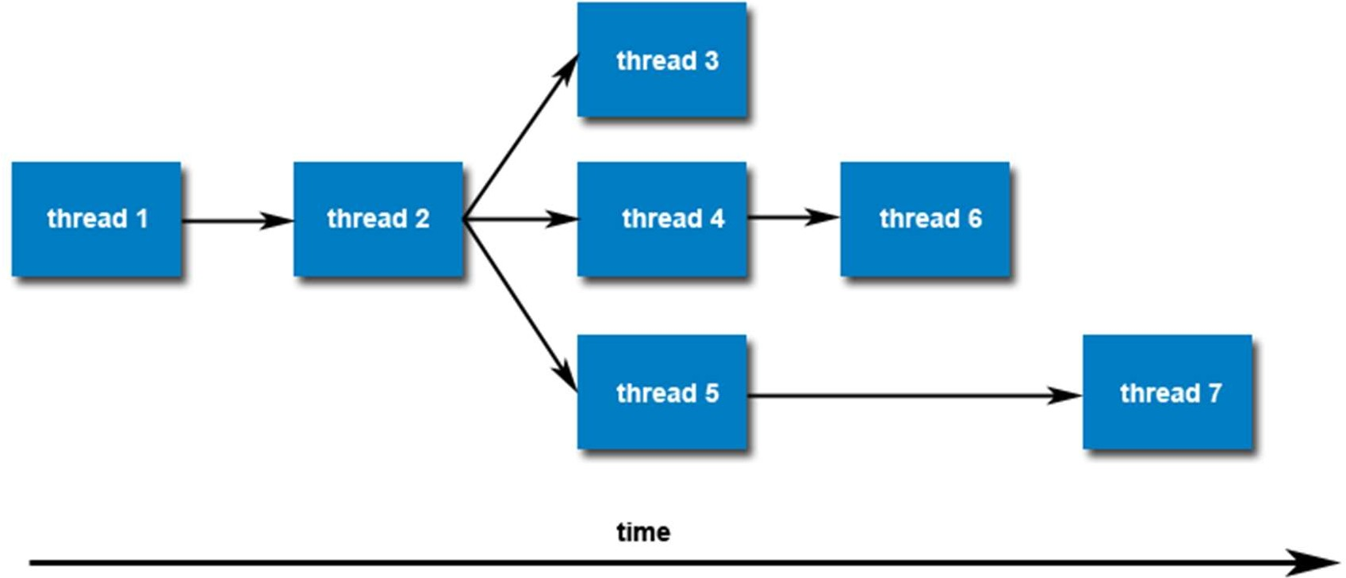
Thread Creation
Once created, threads are peers, and may create other threads
– No implied hierarchy or dependency between threads

Slide 44
Thread Termination
Several ways of termination
The thread makes a call to the pthread_exit() routine
The thread is canceled by another thread via pthread_cancel()
routine
The entire process is terminated due to a call to the exit()
The thread returns from its starting routine/function
Same as if there was an implicit call to pthread_exit() using the return value of thread function as the exit status
Behavior of thread executing main() differs
Effect: Implicit call to exit() using the return value of main() as the exit status
Notes:
When a thread returns from its entry function (the function specified when creating the thread), it is as if there was an implicit call to pthread_exit() using the return value of the thread function as the exit status. This means that returning from the thread function is equivalent to calling pthread_exit() with the return value of the function.
Behavior of the thread executing main() differs:
The thread executing the main() function is treated somewhat differently from other threads. When the main() function returns, it's as if there was an implicit call to exit() using the return value of main() as the exit status. This is how the entire process is typically terminated. Other threads may continue to execute unless explicitly terminated or unless they complete their work.

Slide 45
Thread Termination
int pthread_exit (void *status);
The pthread_exit() routine does not close files
Any files opened inside the thread will remain open after the thread is terminated
If the "initial thread" exits with pthread_exit() instead of
exit(), other threads will continue to execute
The programmer may specify a termination status
Stored as a void pointer for any thread that may join the calling thread i.e., wait for this thread

Slide 46
Thread Termination: Example
#include <pthread.h> #define NUM_THREADS 5
void * PrintHello(void *threadid) { printf("\n%d: Hello World!\n", threadid); pthread_exit(NULL);
}
int main() {
pthread_t threads[NUM_THREADS]; int rc, t;
for(t=0;t < NUM_THREADS; t++) {
printf("Creating thread %d\n", t);
rc = pthread_create(&threads[t], NULL, PrintHello, (void *)&t);
if (rc){
printf("ERROR; return code from pthread_create() is %d\n", rc); exit(-1);
}
}
pthread_exit(NULL);
}
4-Threads
45

Slide 47
Passing Arguments to Threads
The pthread_create permits the programmer to pass one argument to the thread start function
Argument must be passed by reference and cast to (void *)
What if we want to pass multiple arguments?
Create a structure which contains all of the arguments
Pass a pointer to the structure in the pthread_create
Once created threads have non-deterministic start-up & scheduling
How to safely pass data/argument to newly created threads?
Make sure that all passed data is thread safe
i.e., it cannot be changed by other threads
The calling function must ensure that argument remains valid for the new thread throughout its lifetime
At least until thread has finished accessing it
47

Slide 48
Passing Arguments to Threads
Incorrectly passed arguments
for(t=0;t < NUM_THREADS;t++) {
printf("Creating thread %d\n", t);
rc = pthread_create(&threads[t], NULL, printHello,(void *) &t);
...
}
Correctly passed arguments int *tids[NUM_THREADS]; for(t=0;t < NUM_THREADS;t++) {
tids[t] = new int;
*tids[t] = t;
printf("Creating thread %d\n", t);
rc = pthread_create(&threads[t],NULL,PrintHello,(void*)tid[t]);
...
}
48
Notes:
Reasons for the issue:
In this code snippet, you are passing a pointer to the t variable as the argument to the PrintHello function for each thread. This may seem intuitive at first, but it's incorrect for a couple of reasons:
Reasons for the correction:
In this corrected code snippet, you are creating an array of pointers to int called tids. Each element in this array is a dynamically allocated integer, and you correctly set its value to t. Here's why this is the right approach:

Slide 49
Passing Structure as Argument
struct thread_data { int thread_id;
int sum;
};
thread_data thread_data_array[NUM_THREADS];
int main() { ... thread_data_array[t].thread_id = t; thread_data_array[t].sum = sum;
rc = pthread_create(&threads[t], NULL, PrintHello,(void )&thread_data_array[t]) ;
...
}
void *PrintHello(void *threadarg) {
thread_data *my_data;
my_data = (struct thread_data *) threadarg; taskid = my_data->thread_id;
sum = my_data->sum;
...
}
4-Threads 48

Slide 50
Thread Identifier
pthread_t pthread_self(void);
Returns the unique thread ID of the calling thread
int pthread_equal(pthread_t t1, pthread_t t2)
Compares two thread IDs
If the two IDs are different 0 is returned
Otherwise a non-zero value is returned
50

Slide 51
Changing Thread Attributes
int pthread_attr_init(pthread_attr_t *attr);
int pthread_attr_destroy(pthread_attr_t *attr);
To change the (default) attributes of the thread, the following steps can be performed
Initialize attributes object with pthread_attr_init() function
Afterwards, individual attributes of the object can be set using various related functions
pthread_attr_setdetachstate() to set the detached state of thread
pthread_attr_setstacksize() function sets the stack size
When a thread attributes object is no longer required, free library resources using the pthread_attr_destroy() function
51

Slide 52
Changing Thread Attributes: Example
#define NUM_THREADS 5
#define MEGEXTRA 1000000
#define N 1000
Pthread_attr_t attr;
int main() {
pthread_t threads[NUM_THREADS]; int rc, t;
size_t stacksize
pthread_attr_init( &attr); pthread_attr_getstacksize(&attr, &stacksize); printf(“Default stack size - %li\n”, stacksize); stacksize = sizeof(double) * N * N + MEGEXTRA; pthread_attr_setstacksize (&attr, stacksize); for(t=0;t < NUM_THREADS; t++) {
printf("Creating thread with stacksize - %li\n", stacksize);
rc = pthread_create(&threads[t], &attr, PrintHello, (void *)&t);
. . .
}
pthread_attr_destroy(&attr):
. . .
4-Threads
51

Slide 53
Thread Suspension and Termination
Similar to UNIX processes, threads have the equivalent of the
wait() and exit() system calls
int pthread_join (pthread_t thread,
void **status_ptr);
Use to block threads
To instruct a thread to block and wait for a thread to complete
Any thread can call join on (and hence wait for) any other thread
Serves as a mechanism to get a return value from a thread
4-Threads

Slide 54
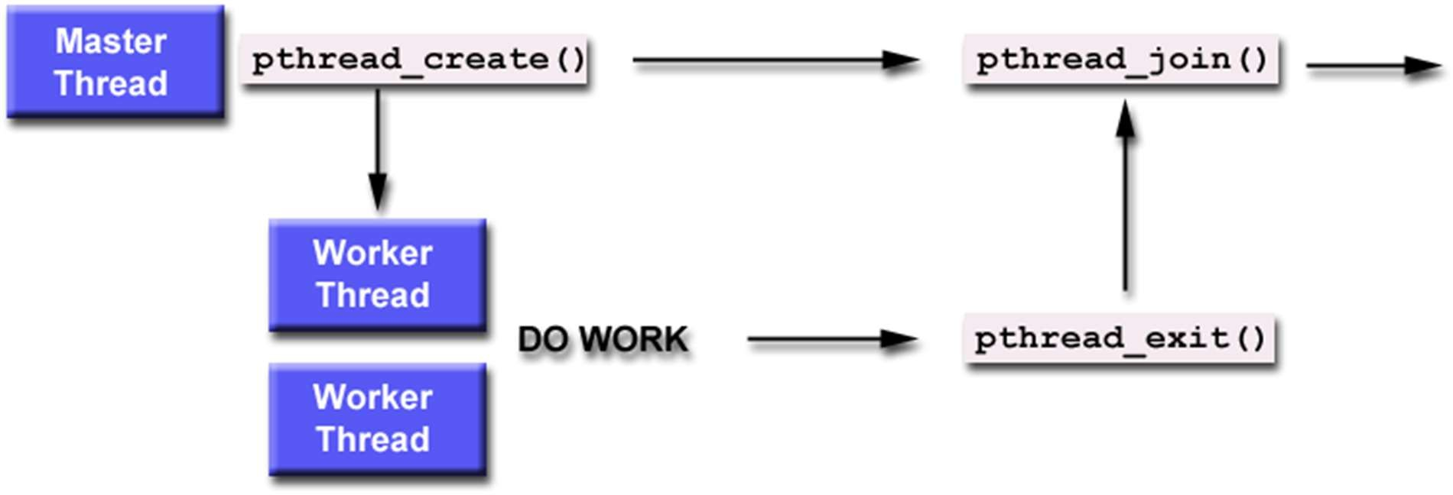
Thread Suspension and Termination
4-Threads

Slide 55
Joinable Threads
When a thread is created, one of its attributes defines whether it is joinable or detached
Only threads that are created as joinable can be joined
If a thread is created as detached, it can never be joined
Detached Thread
On termination all thread resources are released by the OS
A detached thread cannot be joined
No way to get at the return value of the thread
Joinable Thread
On thread termination thread ID and exit status are saved by the OS
Joining a thread means waiting for a thread with a certain ID
One way to accomplish synchronization between threads
4-Threads

Slide 56
Joinable Threads
Multiple threads cannot wait for the same thread to terminate
If multiple thread simultaneously try to join, the results are undefined
For example, only one thread returns successfully
The other threads fail with an error of ESRCH or EINVAL
After pthread_join()returns, any stack storage associated with the thread can be reclaimed by the process
Threads which have exited but have not been joined are equivalent to zombie processes
Their resources cannot be fully recovered
4-Threads
Notes:
It's essential to join or detach threads to avoid leaving zombie threads in your multithreaded application. If you don't join or detach threads, they may accumulate and potentially lead to resource exhaustion or memory leaks.

Slide 57
Joinable Threads: Example
#include <stdio.h> #include <pthread.h>
/* Set threads properties */
pthread_attr_init(&attr); pthread_attr_setdetachstate(&attr, PTHREAD_CREATE_JOINABLE);
/* Create new thread */
rc = pthread_create(&child_thread, &attr, (void*) &child_code, NULL);
/* Free attributes object */
pthread_attr_destroy(&attr);
/* concurrent computation */ x=x+5;
printf("x has change to %d\n",x);
int x = 5;
int child_code()
{
while (x>0){ x=x-1;
printf("x has changed to %d\”
,x);
}
return 0;
}
int main(int argc, char *argv[])
{
int rc;
void** status=0; pthread_t child_thread; pthread_attr_t attr;
/*wait for thread to terminate */ pthread_join(child_thread, status); pthread_exit(NULL);
}
4-Threads

Slide 58
Possible Outcome
No deterministic execution!
Two threads can interleave in multiple ways
Requires further synchronization
Child: x=5
while (x>0){ x=x-1;
printf("x has changed to %d \n",x);
}
x has changed to 4
x has changed to 3
Parent: x=3
x=x+5;
printf("x has changed to %d\n",x);
x has changed to 8
x has changed to 7
…
x has changed to 1
x has changed to 0
Child: x=3
while (x>0){ x=x-1;
printf("x has changed to %d \n",x);
}
4-Threads

Slide 59
Joinable Threads: Example
#include <pthread.h> #define NUM_THREADS 4
/* Initialize & set thread attribute */ pthread_attr_init(&attr); pthread_attr_setdetachstate(&attr,
PTHREAD_CREATE_JOINABLE);
for(t=0; t<NUM_THREADS; t++) {
printf("Main:creating thread %ld\n", t);
pthread_create(&thread[t], &attr, BusyWork, (void *)t);
}
/* Free attribute & wait for threads */
pthread_attr_destroy(&attr); for(t=0; t<NUM_THREADS; t++) {
pthread_join(thread[t], &status);
printf("Main: completed join with thread
%ld with status %ld\n", t, (long)status);
}
printf("Main: program completed. \n");
pthread_exit(NULL);
void *BusyWork(void *t){ long tid = (long)t; double result=0.0;
printf("Thread %ld starting...\n",tid);
for (int i=0; i<1000000; i++){ result = result + sin(i) * tan(i);
}
printf("Thread %ld done.
Result = %e\n",tid, result);
pthread_exit((void*) t);
}
int main (int argc, char *argv[]) { pthread_t thread[NUM_THREADS]; pthread_attr_t attr;
int rc; long t;
void *status;
}
4-Threads

Slide 60
Possible Output
Main: creating thread 0 Main: creating thread 1 Thread 0 starting...
Main: creating thread 2 Thread 1 starting...
Main: creating thread 3 Thread 2 starting...
Thread 3 starting...
Thread 1 done. Result = -3.153838e+06 Thread 0 done. Result = -3.153838e+06
Main: completed join with thread 0 with status of 0 Main: completed join with thread 1 with status of 1 Thread 3 done. Result = -3.153838e+06
Thread 2 done. Result = -3.153838e+06
Main: completed join with thread 2 with status of 2 Main: completed join with thread 3 with status of 3 Main: program completed. Exiting.
4-Threads

Slide 61
Making a Thread Detached
int pthread_detach (pthread_t thread_id);
Function marks the thread identified by thread_id as detached
Return 0 on success
To avoid memory leaks a thread should
Either be joined
Or detached by a call to pthread_detach()
Once a thread is detached using this function, it cannot be make joinable again
Threads can detach themselves by calling pthread_detach() with an argument of pthread_self( )
i.e., pthread_detach( pthread_self())
4-Threads

Slide 62

Any Question So Far?
4-Threads

